Slide 1
Analysing
Movie Box
By: Pham Ngoc Tran Vu

Slide 2
Return on Investment by Genre
Horror and Drama movies generated the highest ROI, while Thriller/Suspense produced the lowest average return.

Slide 3
International vs. Domestic Revenue
Most movies earned significantly more revenue from international markets than domestic markets.

Slide 4
Percentage Domestic Revenue
Domestic revenue represented between 20% and 60% of total box office revenue for most movies.
High-grossing films generally relied heavily on international markets.

Slide 5
Total Revenue vs Product Budgets
Movies with larger production budgets generally earned higher revenues, however several high-budget films underperformed.

Slide 6
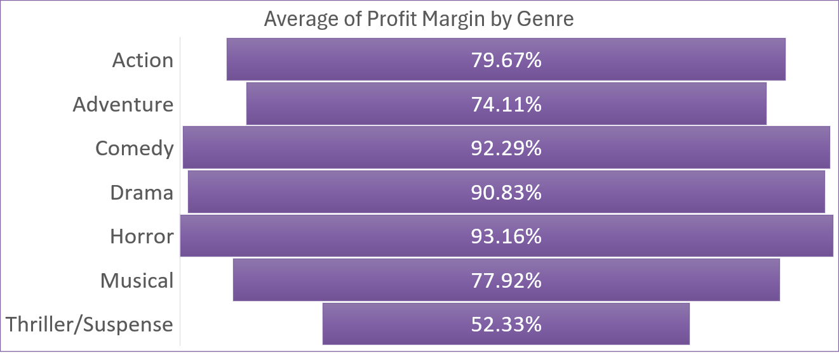
Average of Profit Margin
Horror and Comedy achieved the highest average profit margins, suggesting that these genres often produce strong financial returns despite relatively moderate production costs.

Slide 7
Summarize
Horror movies yield the highest ROI, Thriller/Suspense show the lowest.
Most movies generate higher revenue from international markets than from the domestic market.
Domestic revenue typically accounts for 20–60% of total revenue.
High-budget films often achieve high revenue; However, some low-budget movies have achieved a higher ROI than several high-budget films.
Movies tend to be released in large numbers during the summer and spring.

Slide 8
The
end

